Slide 1
Kick off meeting project
Giải thích và nêu ý kiến về cách làm việc cho team.
Đề xuất các thỏa thuận giữa các team member.
Nêu phase, requirement của dự án.
Thỏa thuận lịch làm việc cho team.
Date: 10/5/2016
Member:
Võ Trần Chí.
Đinh Bảo Trân.
Ngô Tấn Khôi.

Slide 2

Mục tiêu của Capstone kì này
“ Tất cả các team member được giữ lại để ra bảo vệ đồ án. ”

Slide 3









Thỏa thuận giữa các team member.
Sự thành thật giữa các team member.
Tinh thần trách nhiệm.
Sự tin tưởng.
Sẵn sàng để học những cái mới.
Sẵn sàng giúp đỡ các team member khác.
Sẵn sàng chia sẻ kiến thức.
Sẵn sàng lên tiếng.
Tôn trọng lẫn nhau.

Slide 4
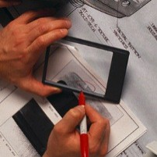
Nêu phase, requirement của dự án.
Data acquisition
Data Processing
Data Transfer
Application

Slide 5
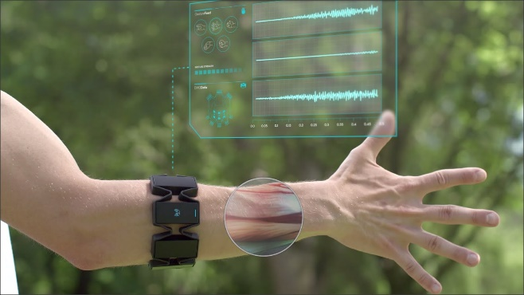
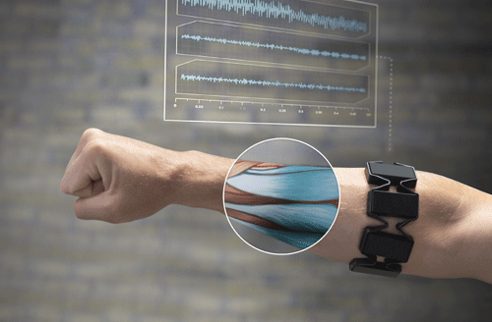
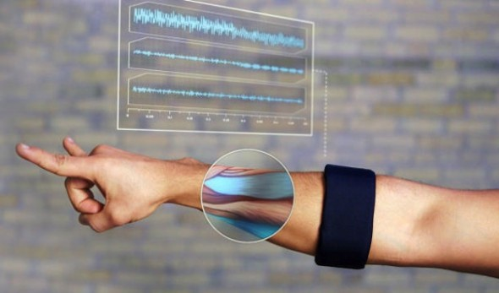

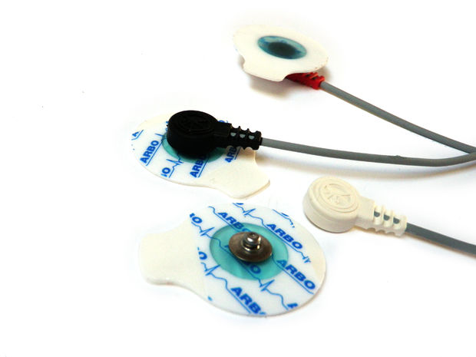
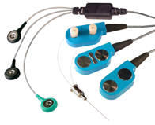
Data
acquisition
Nêu phase, requirement của dự án.

Slide 6
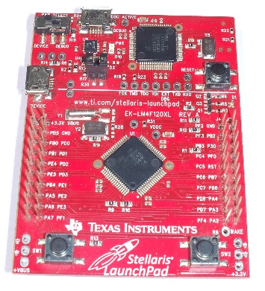
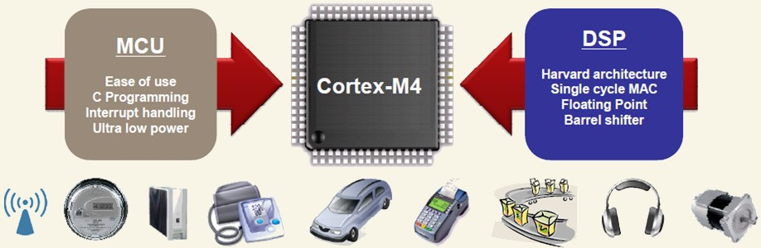
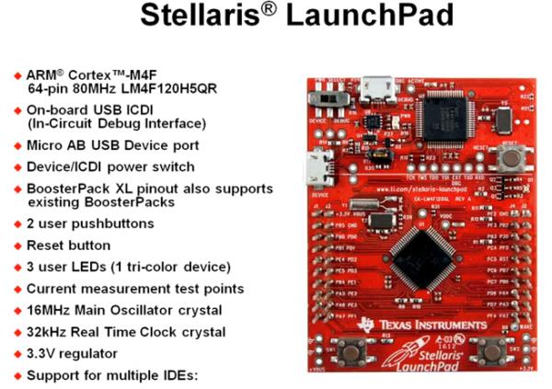
Data Processing

Slide 7
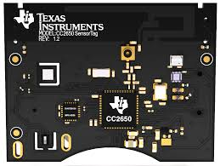
Data Transfer

Slide 8
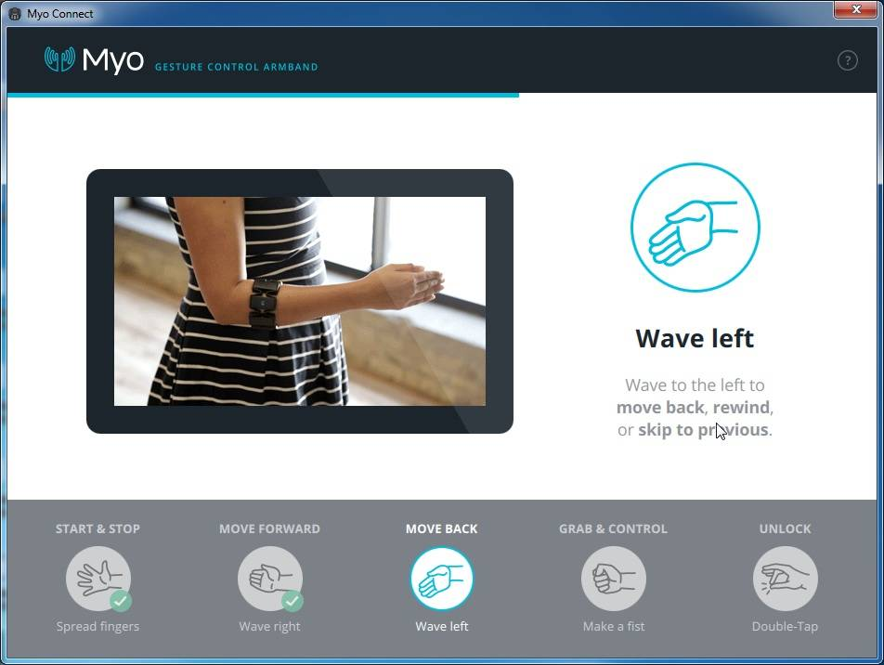
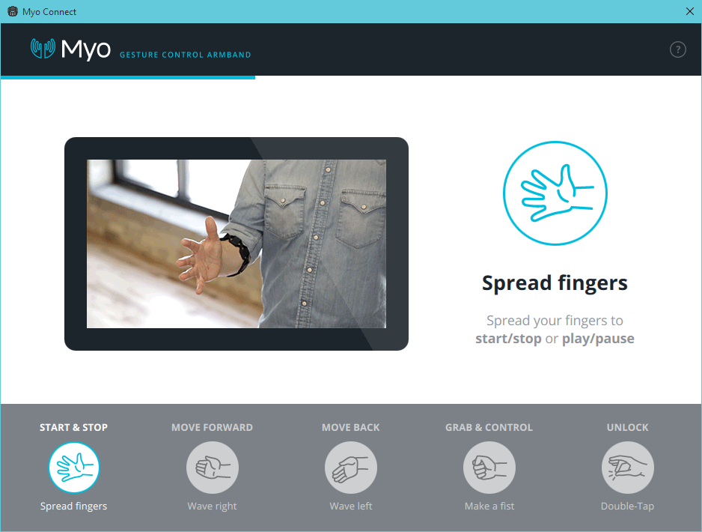
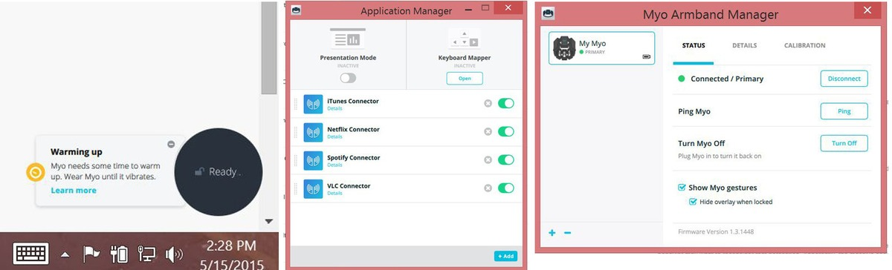
Application

Slide 9



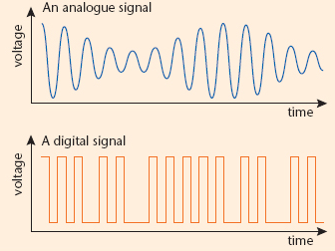
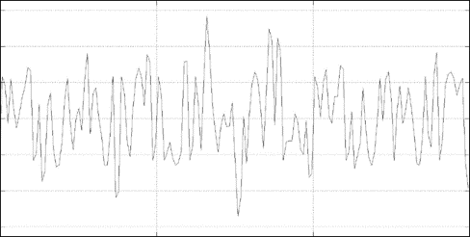
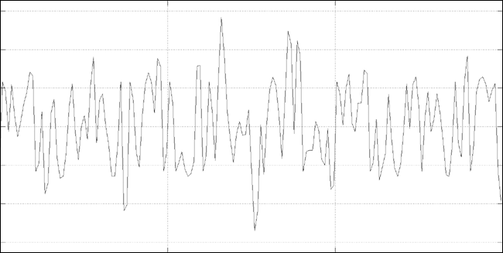

Input | Output
Processed data | Digital data
Microcontroller
Physical wire
Physical wire
2 core:
1 for digitalizing signal
1 for RF
Processing Circuit
Electrodes
Bluetooth adapter
Input | Output
EMG raw data | Filtered, processed data
Bluetooth protocol
Input | Output
EMG raw data | EMG raw data
Bluetooth core
Input | Output
Digital data | GAT command
Nêu phase, requirement của dự án.
Computer
Application

Slide 10


Microcontroller
Buzzer motor
Physical wire
Physical wire
Physical wire
Physical wire
Processing Circuit
Electrodes
Bluetooth adapter
Bluetooth protocol
LED
Bluetooth core
Computer
Application

Slide 11
Data transfer
( Ngô Tuấn Khôi )
Computer Application
( Đinh Bảo Trân )
Data Acquisition and Processing
( Võ Trần Chí )
Nêu phase, requirement của dự án.

